Slide 1
Social Media
Quick Design Guide
Bayer Communications
November 2021

Slide 2
Introduction
Quick Design Guide
Bayer offers templates for a globally consistent brand experience on the company social media channels.
There are individual PowerPoint templates regarding three general post types and the specific requirements for each social media platform.
This guideline offers helpful tips and tricks to edit the templates flexibly to local needs according to the Bayer corporate design guidelines.

Slide 3
Post Types
Quick Design Guide

Slide 4
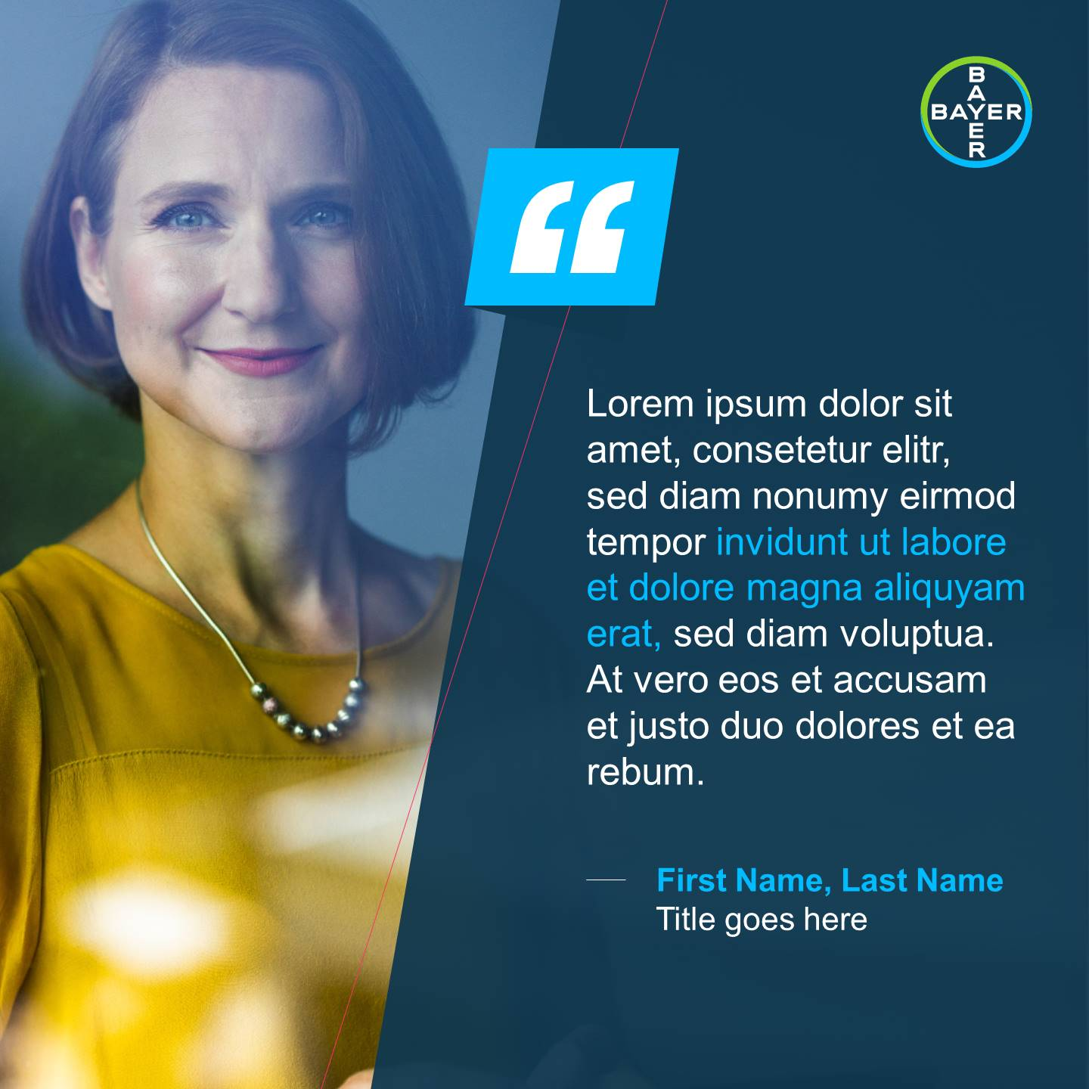
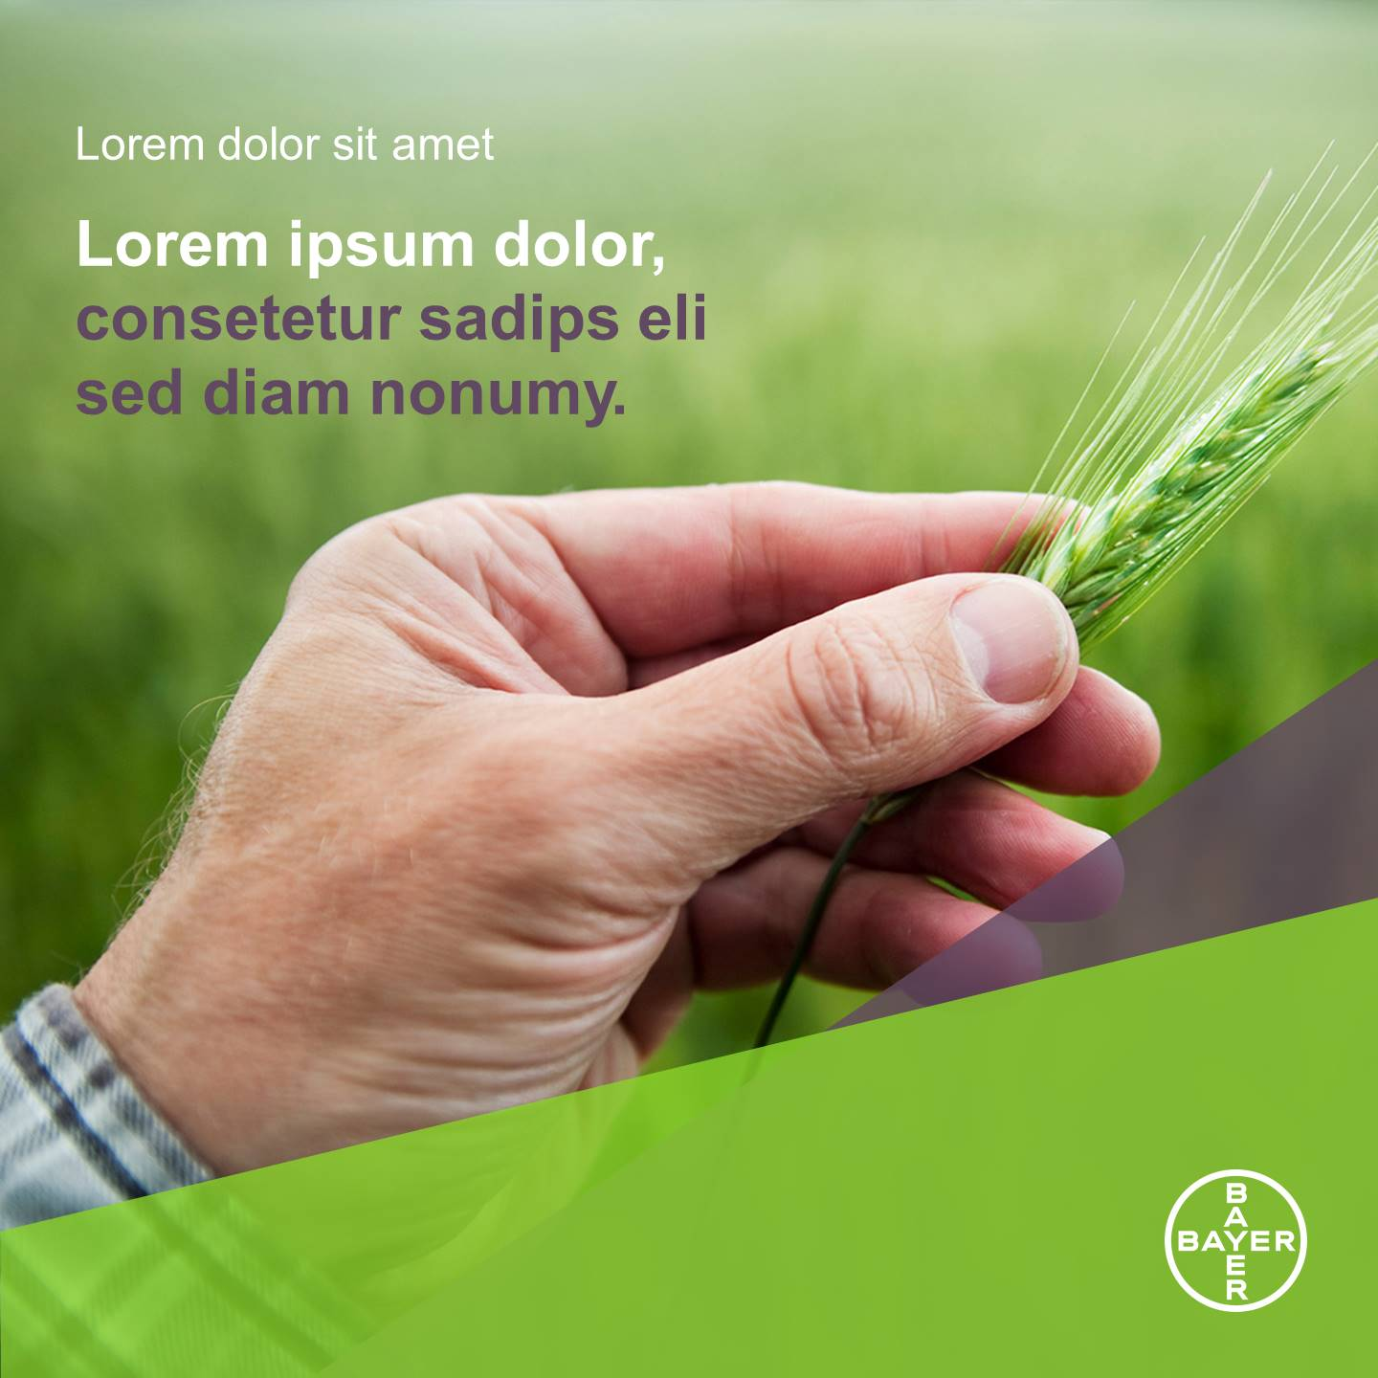
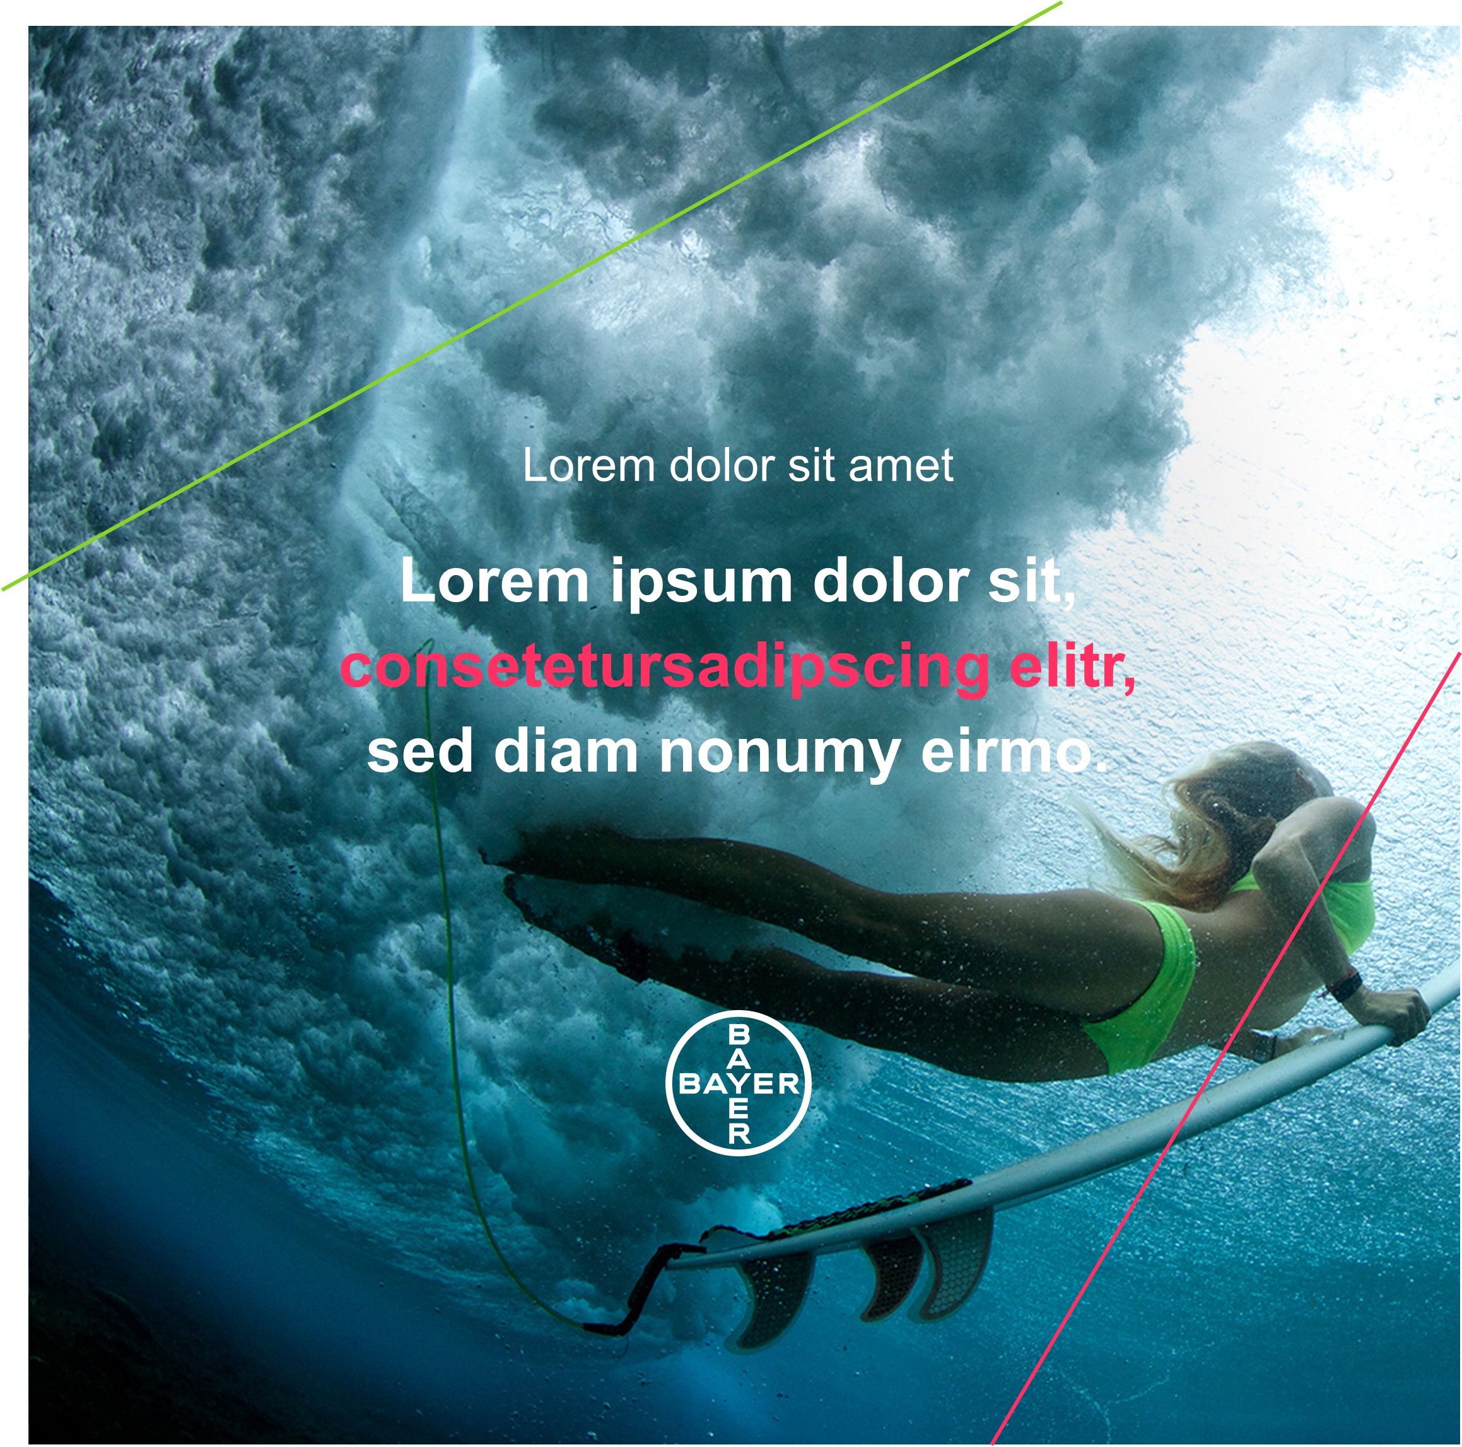
Post Types
Overview
Quote Cards
Text Box
Company Announcements
Stories
This social media toolbox offers a selection of templates for the three most important channels (Facebook, Instagram and LinkedIn) in order to represent Bayer uniformly and in accordance with Bayer visual identity requirements via the social media channels:
Quote Cards
Text Box
Company Announcements
Stories
Social Media platforms

Slide 5
Edit basic Post
PowerPoint Short Guide
Basic Post Example
The PPT templates in the appropriate formats (Instagram, Facebook, LinkedIn) enable simple and uniform creation of social media posts.
The layout of the respective post can also be personalized.
In addition to the color of the elements, text and images can also be exchanged and adapted.
Inserting image
Click on the picture and select the desired picture via “Fill Effect-> Picture-> From File”. Then click on the picture and then at the top on “Image Format-> Crop-> Fill”
Change color
Click on the desired element and select a different color from the color pool via “Fill Effect”.
Edit text
Click in the text placeholder and enter the text you want. To change the text color, select the text and choose a desired color via “Font color”.
Export file
To export the design for the post on the social media channel, click on “File-> Export-> Change file type-> Jpeg”.
/// Bayer Communications /// Quick Design Guide Social Media /// November 2021

Slide 6
Edit animated Post
PowerPoint Short Guide
Animated Post Example (click below on ‘Play’ button)
In order to increase the attention of the post, the respective elements can be easily animated. However, it is advisable to limit the animation to a few basic animations in order not to distract from the essential content.
To do this, proceed as follows:
Click the element that you want to animate
In the animation area, select the animation you want
Wipe-in animation
The Element comes wiped in from a desired direction
Fade-in animation
The element is faded in softly.
Export as animated file
To export the design for the post on the social media platform as animated file, click on “Save as” -> “Windows Media Video” or “MP4”.

Slide 7
Thank you!

